Slide 1
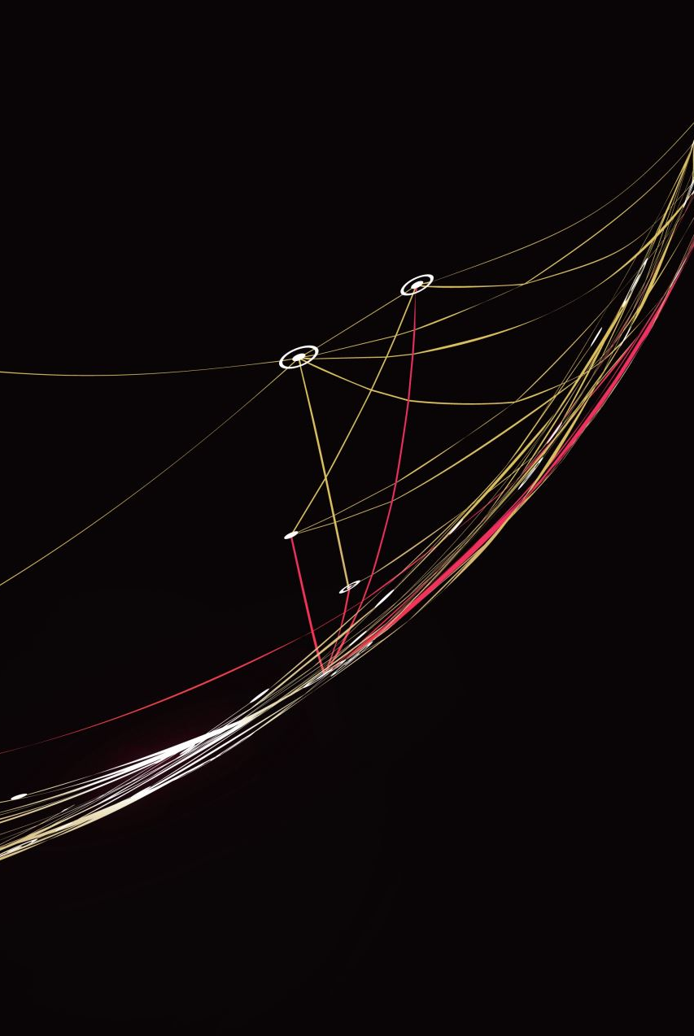
Telecom Churn Prediction
Group A

Slide 2
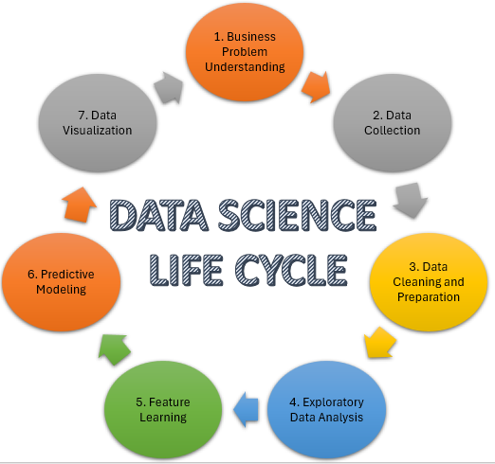
Project Recap
What is churn?

Slide 3

Exploratory Data Analytics Highlights

Slide 4
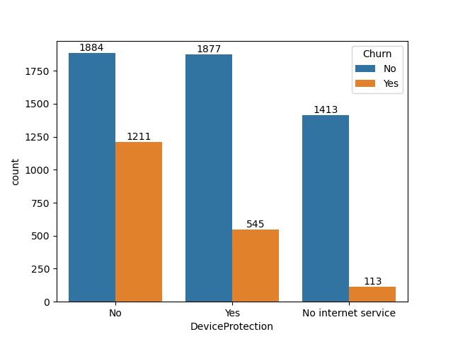
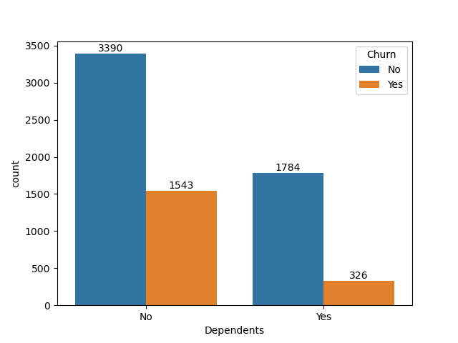
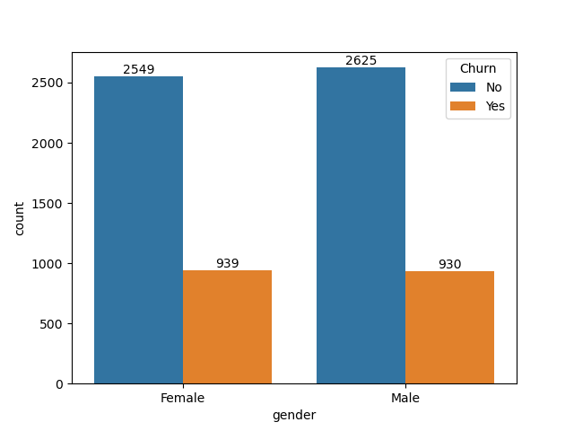
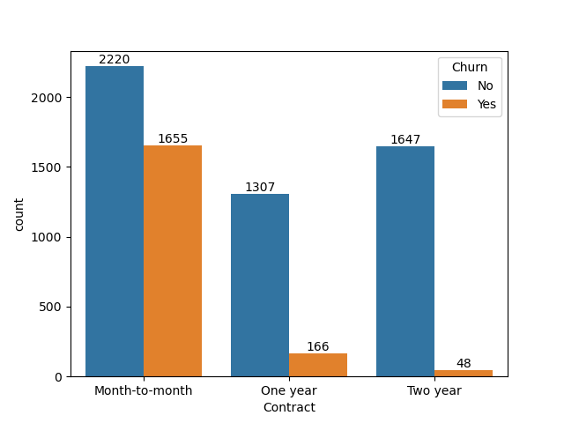
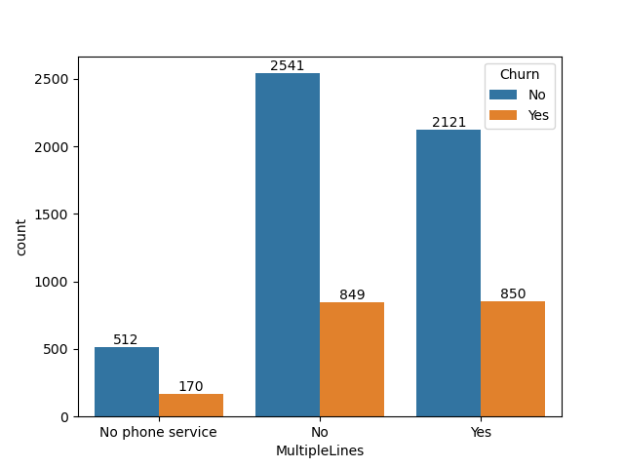
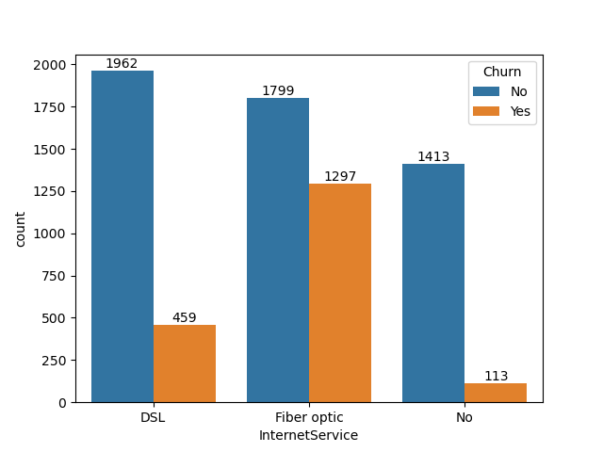
Data overview
Device Protection
Dependents
Gender
Contract
Multiple Lines
Internet Service

Slide 5
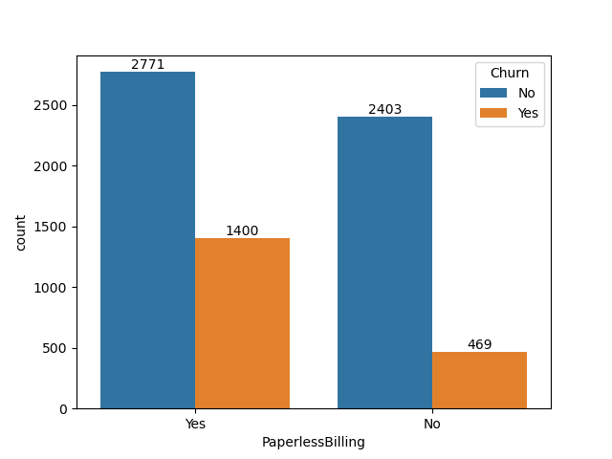
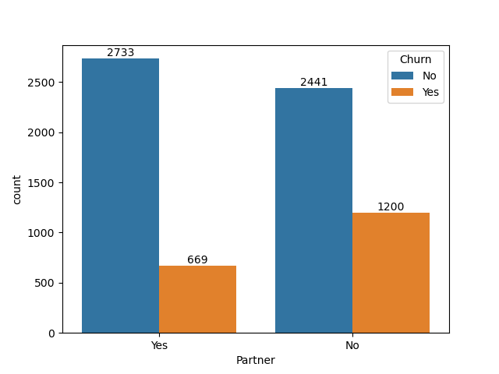
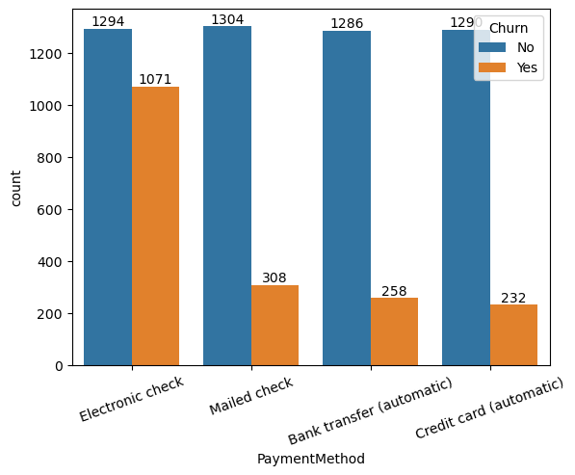
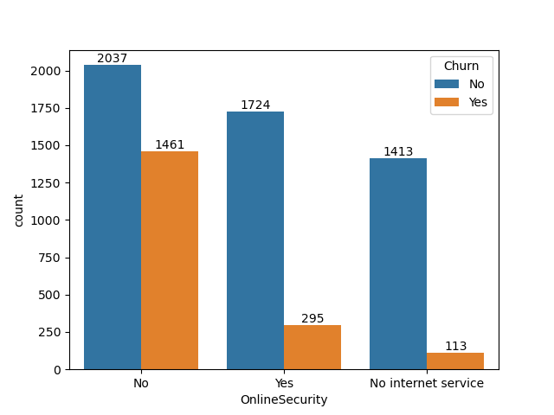
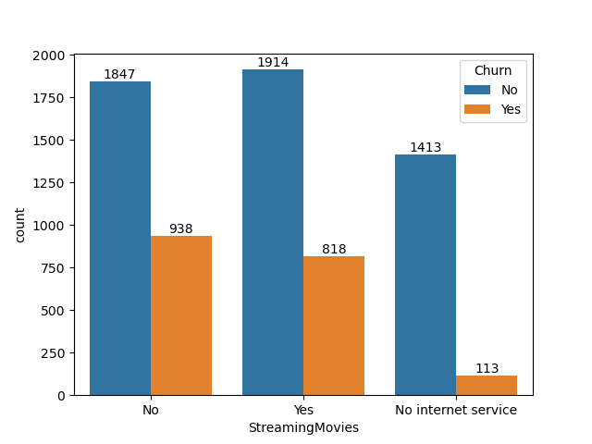
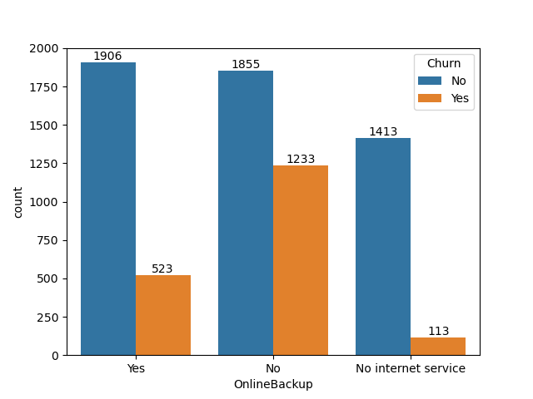
Payment Method
Partner
Paperless Billing
Online Security
Streaming Movies
Online Backup

Slide 6
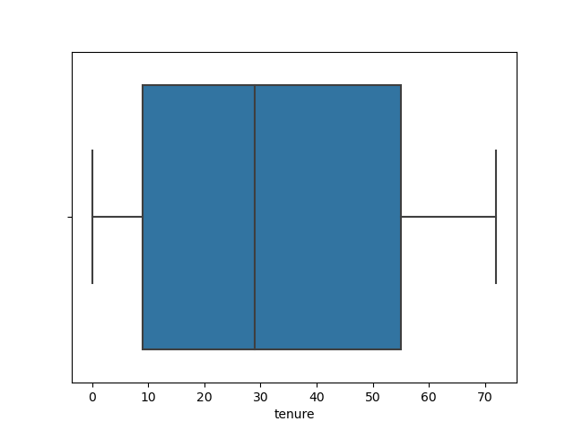
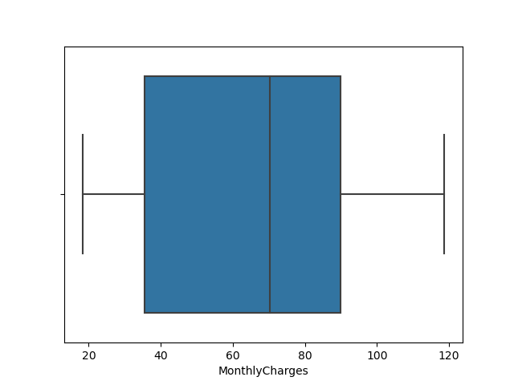
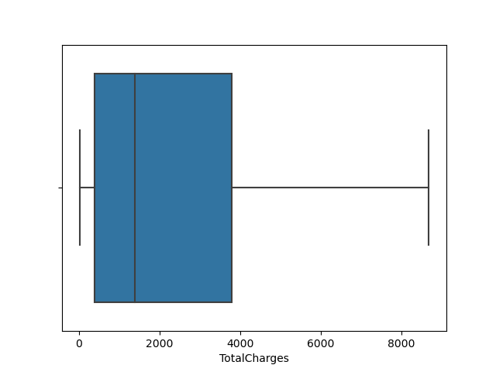
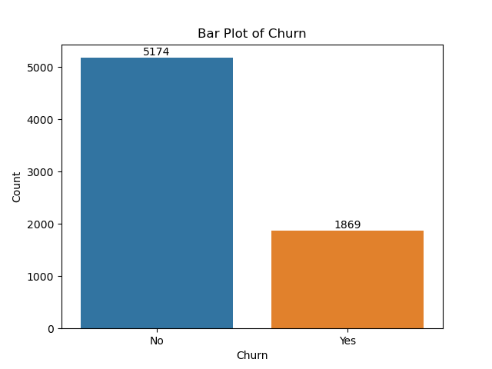
Tenure
Monthly Charges
Total Charges

Slide 7
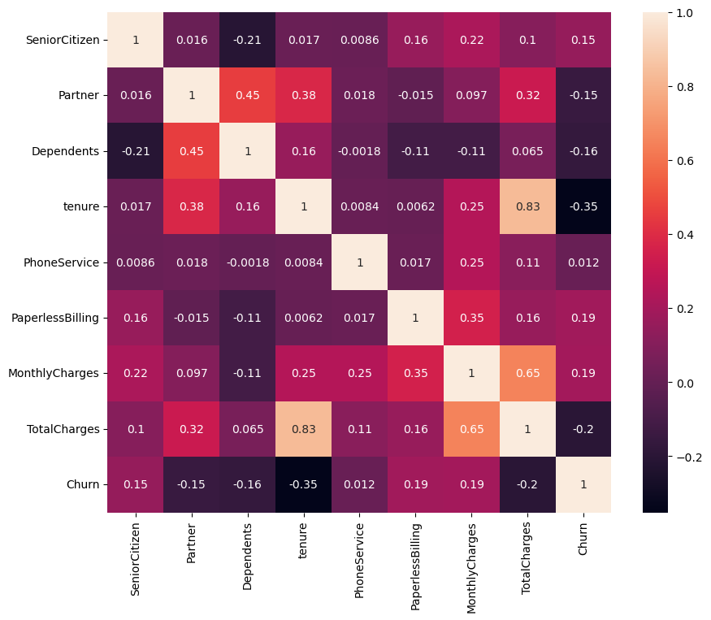
correlation plot

Slide 8
Handling Imbalanced Data
SMOTE (Synthetic Minority Over-sampling Technique):
An oversampling technique used to address class imbalance in classification problems.
It works by generating synthetic samples from the minority class rather than duplicating existing samples.
It selects examples that are similar (nearest neighbors) to the minority class samples and creates new instances along the line segments joining these instances.
Helps in balancing class distribution and improving the performance of classifiers, especially when the minority class is underrepresented.
Random UnderSampler:
An undersampling technique used to address class imbalance in classification problems.
It works by randomly removing samples from the majority class to balance the class distribution.
It helps in reducing the number of majority class samples, making the dataset more balanced and reducing the dominance of the majority class in the training process.
Simple to implement and computationally efficient, but it may discard useful information and lead to loss of important data, especially in scenarios with limited data.

Slide 9
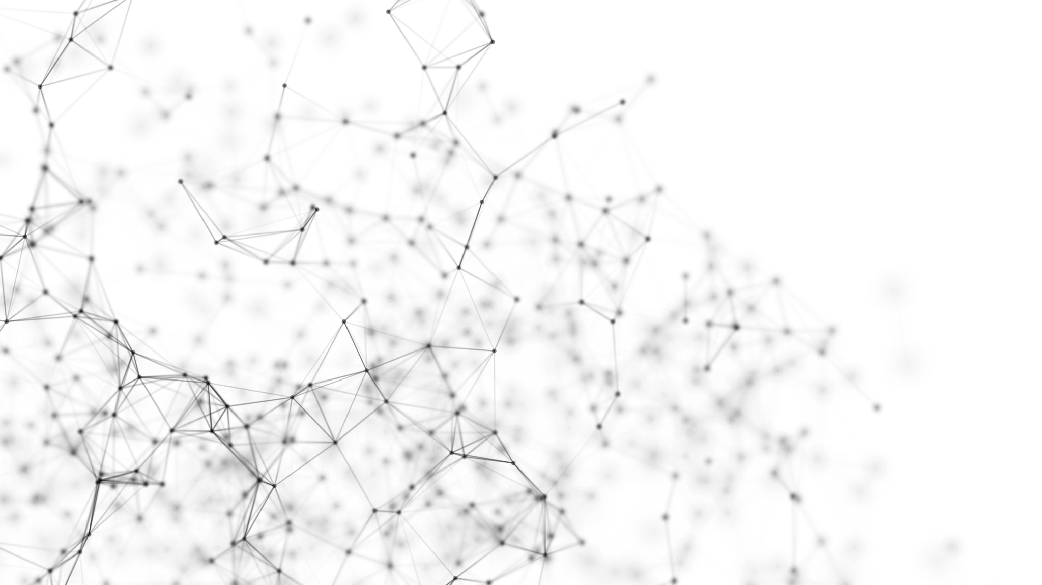
Model building

Slide 10
Models used
Logistic Regression
Support Vector Machine (SVM)
K-Nearest Neighbors (KNN)
Random Forest
Decision Trees

Slide 11
1. Logistic Regression
- A statistical method used for binary classification.
- It models the probability of a binary outcome based on one or more predictor variables.
- It uses the logistic function to map the output of the linear equation to the range [0, 1], representing probabilities.
- Despite its name, it's a classification algorithm, not a regression one.
2. Support Vector Machine (SVM)
- A powerful supervised learning algorithm used for classification and regression tasks.
- It finds the optimal hyperplane that separates data points into different classes.
- Works by maximizing the margin between the hyperplane and the closest data points (support vectors).
- Can handle linear and non-linear decision boundaries using different kernel functions (e.g., linear, polynomial, radial basis function).

Slide 12
3. K-Nearest Neighbors (KNN)
- A simple and intuitive classification algorithm based on the idea that similar data points tend to belong to the same class.
- It classifies a data point by a majority vote of its k nearest neighbors (data points with the closest distance).
- The value of k (number of neighbors) is a hyperparameter that needs to be tuned.
- Works well with small datasets but can be computationally expensive for large datasets due to its lazy learning approach.
4. Random Forest
- An ensemble learning method that builds multiple decision trees during training and merges them to make predictions.
- Each tree in the forest is trained independently using a subset of the data and a random subset of features.
- Combines the predictions of individual trees through averaging (regression) or voting (classification) to improve accuracy and reduce overfitting.
- Effective for both classification and regression tasks, and less sensitive to outliers and noisy data compared to individual decision trees.

Slide 13
5. Decision Trees
- A simple yet powerful supervised learning algorithm used for classification and regression tasks.
- It creates a tree-like structure where each internal node represents a feature, each branch represents a decision based on that feature, and each leaf node represents a class label or a continuous value.
- The tree is built recursively by splitting the dataset into subsets based on the value of the features that best separate the classes (using metrics like Gini impurity or information gain).
- Decision trees are easy to interpret and visualize, but they can overfit the training data if not pruned properly.

Slide 14
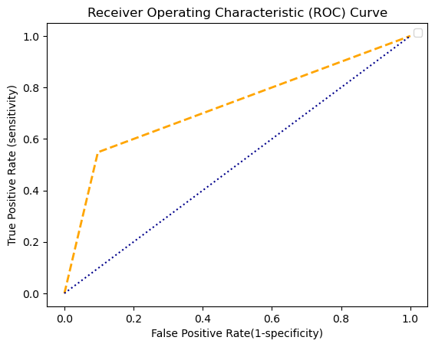
Logistic regression
Confusion Matrix:
[[1418 152]
[ 244 296]]
Accuracy: [0.81232227]
Sensitivity : [0.85318893]
Specificity : [0.66071429]
Precision: [0.90318471]
Recall: [0.85318893]
F-score: [0.87747525]
AUC: 0.7256664307619722

Slide 15
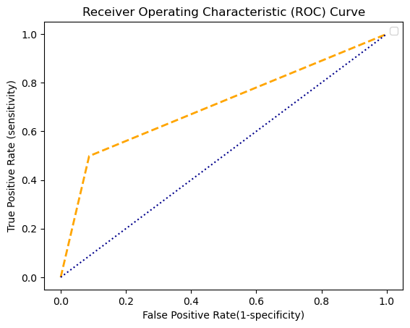
Support Vector Machine (SVM)
Confusion Matrix:
[[1433 137]
[ 271 269]]
Accuracy: [0.80663507]
Sensitivity : [0.84096244]
Specificity : [0.66256158]
Precision: [0.91273885]
Recall: [0.84096244]
F-score: [0.8753818]
AUC: 0.7054435008256664

Slide 16
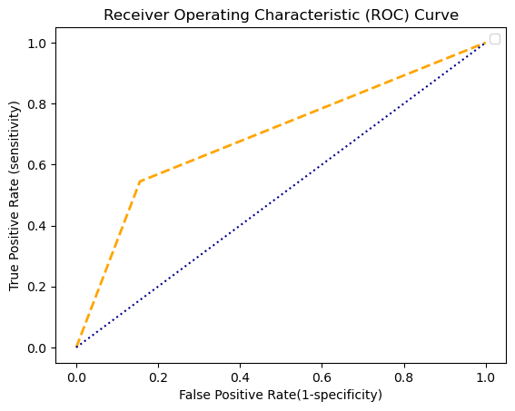
K-Nearest Neighbors (KNN)
Confusion Matrix:
[[1326 244]
[ 246 294]]
Accuracy: [0.76777251]
Sensitivity : [0.84351145]
Specificity : [0.5464684]
Precision: [0.84458599]
Recall: [0.84351145]
F-score: [0.84404838]
AUC: 0.6945152158527954

Slide 17
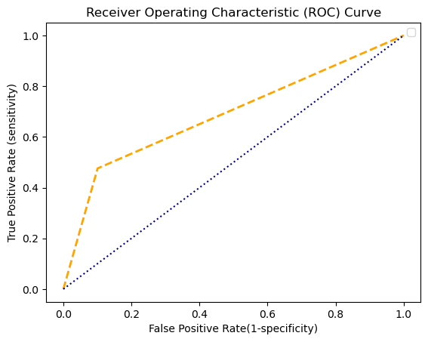
Random Forest
Confusion Matrix:
[[1412 158]
[ 283 257]]
Accuracy: [0.79099526]
Sensitivity : [0.83303835]
Specificity : [0.61927711]
Precision: [0.89936306]
Recall: [0.83303835]
F-score: [0.86493109]
AUC: 0.6876444916253833

Slide 18

Decision Trees
Confusion Matrix:
[[1260 310]
[ 268 272]]
Accuracy: [0.72606635]
Sensitivity : [0.82460733]
Specificity : [0.46735395]
Precision: [0.80254777]
Recall: [0.82460733]
F-score: [0.81342802]
AUC: 0.6531257372021703

Slide 19

Moving forward

Slide 20
Improvements
Data Balance
Boosting Techniques
Hyperparameter tuning

Slide 21
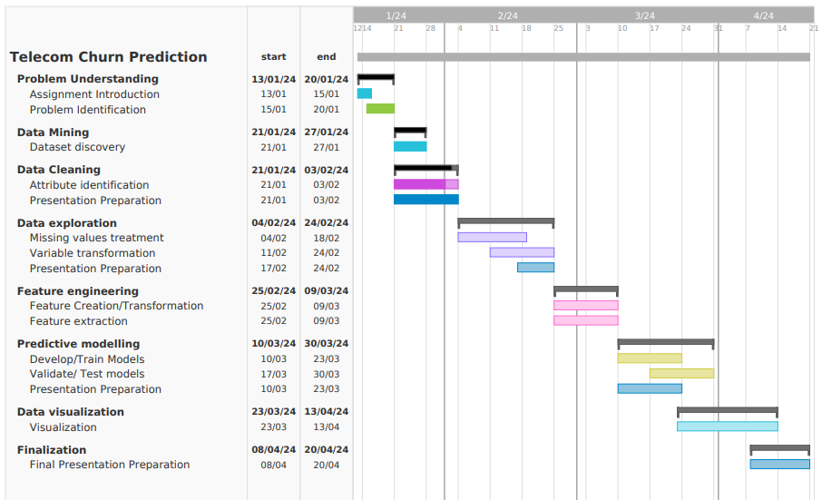
Gantt Chart

Slide 22

Any questions?

